Slide 1
A common neural basis for contrast and motion coherence perception
Dan Birman
Gardner Lab
Frisem 2017-06-26

Slide 3
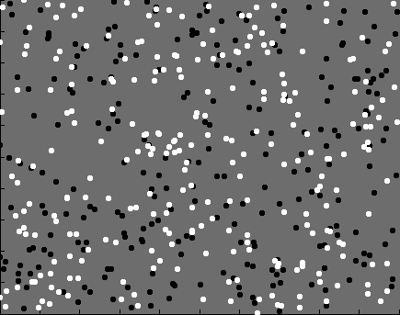

Slide 4
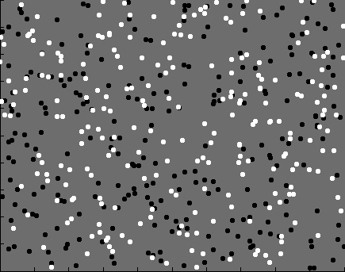
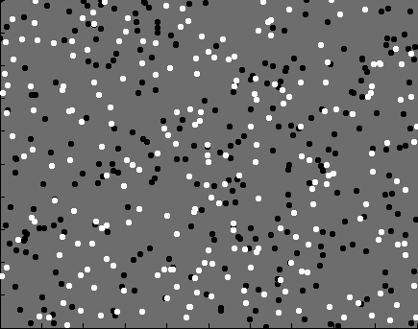
Contrast

Slide 5
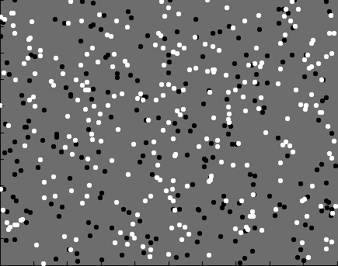
Coherence

Slide 6


Slide 7
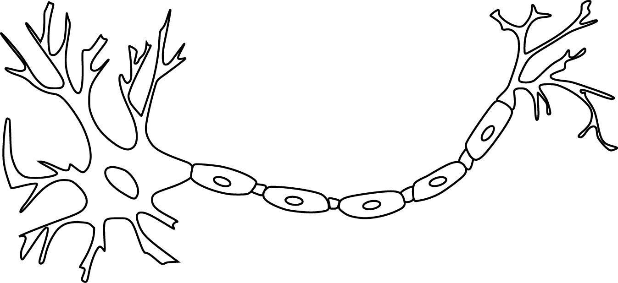

Slide 9
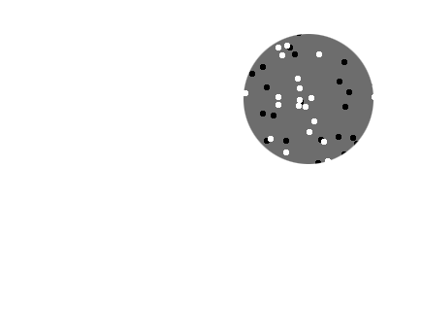
Receptive field

Slide 10
Receptive field

Slide 11
Receptive field

Slide 12
Population
Receptive field

Slide 15
Is perception linked to population representations?

Slide 16
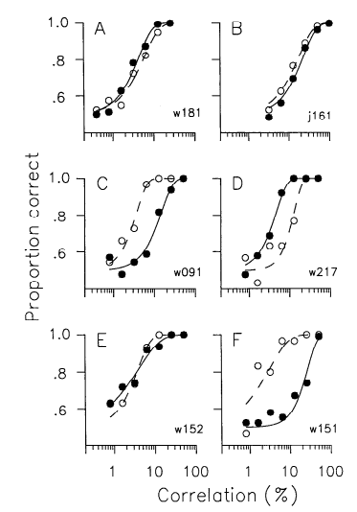
Is perception linked to population representations?
Britten et al. 1992

Slide 17
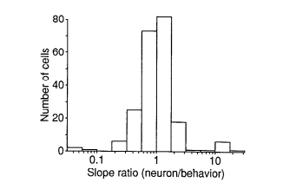
Is perception linked to population representations?
Britten et al. 1992

Slide 18
Is perception linked to population representations?

Slide 19
Is perception linked to population representations?

Slide 20
Is perception linked to population representations?

Slide 22
Representation of contrast?
Boynton et al. 1999

Slide 23
Representation of contrast?
Boynton et al. 1999
Representation of coherence?
Rees and Koch 2000
Simoncelli and Heeger 1997

Slide 24
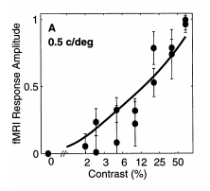
Representation of contrast?
Boynton et al. 1999
Representation of coherence?
Rees and Koch 2000
Simoncelli and Heeger 1997

Slide 25
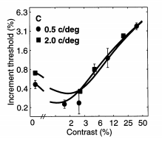
Representation of contrast?
Boynton et al. 1999
Representation of coherence?
Rees and Koch 2000
Simoncelli and Heeger 1997

Slide 26
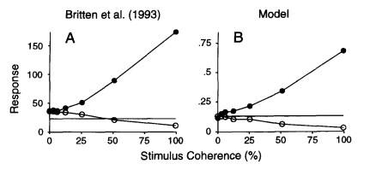
Representation of contrast?
Boynton et al. 1999
Representation of coherence?
Simoncelli and Heeger 1997

Slide 27
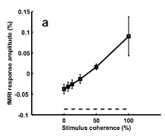
Representation of contrast?
Boynton et al. 1999
Representation of coherence?
Rees and Koch 2000

Slide 28
Goal: A model linking population representations of contrast and motion coherence to perception

Slide 29
Goal: A model linking population representations of contrast and motion coherence to perception
Cortical measurements of BOLD fMRI
Behavioral measures of perception

Slide 30
Goal: A model linking population representations of contrast and motion coherence to perception
Cortical measurements of BOLD fMRI
Behavioral measures of perception

Slide 31
Goal: A model linking population representations of contrast and motion coherence to perception
Cortical measurements of BOLD fMRI
Behavioral measures of perception

Slide 32
Goal: A model linking population representations of contrast and motion coherence to perception
Cortical measurements of BOLD fMRI
Characterize the response properties of population representations
Behavioral measures of perception

Slide 36
Luminance changes = bad

Slide 41
Cortical measurements

Slide 42
Cortical measurements
11 observers, asynchronous task at fixation
800+ trials (20 per experimental condition)
1 hr retinotopy
4 x 2 hr scanning sessions

Slide 43
Area V1
Area MT

Slide 45
Within-subject analysis: display average across subjects

Slide 46
Within-subject analysis: display average across subjects
Timecourses were averaged within visual areas

Slide 47
Within-subject analysis: display average across subjects
Timecourses were averaged within visual areas
Deconvolution (GLM/finite impulse response) used to obtain separated per-condition measurements

Slide 49
Contrast

Slide 50
Contrast

Slide 51
Contrast

Slide 52
Contrast
Coherence

Slide 53
Contrast
Stimulus length
Coherence

Slide 68
Contrast

Slide 69
Contrast
Coherence

Slide 70
Contrast
Stimulus length
Coherence

Slide 73
Population response model for cortical measurements

Slide 82
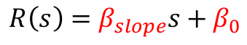
$$R\left(s\right)=β_{slope}s+β_{0}$$
Feature strength

Slide 83
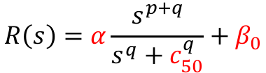
$$R\left(s\right)=β_{slope}s+β_{0}$$
$$R\left(s\right)=α\frac{s^{p+q}}{s^{q}+c_{50}^{q}}+β_{0}$$
Feature strength

Slide 84
$$R\left(s\right)=β_{slope}s+β_{0}$$
$$R\left(s\right)=α\frac{s^{p+q}}{s^{q}+c_{50}^{q}}+β_{0}$$
Feature strength

Slide 86
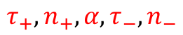
Difference of gammas:
$$τ_{+}, n_{+},α,τ_{−},n_{−}$$

Slide 87
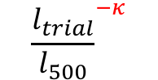
$${\frac{l_{trial}}{l_{500}}}^{−κ}$$

Slide 88
Parameters fit across all conditions

Slide 100
Contrast (% signal change / % contrast)

Slide 101
Coherence (% signal change / % contrast)
Contrast (% signal change / % contrast)

Slide 102
Coherence (% signal change / % contrast)
Contrast (% signal change / % contrast)

Slide 103
Coherence (% signal change / % contrast)
Contrast (% signal change / % contrast)

Slide 104
Coherence (% signal change / % contrast)
Contrast (% signal change / % contrast)

Slide 110
Is the motion coherence response linear?

Slide 111
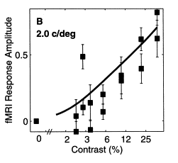
Previous work suggests the contrast
response is a Naka-Rushton function
Is the motion coherence response linear?

Slide 112
Is the motion coherence response linear?

Slide 113
Is the motion coherence response linear?

Slide 114
Is the motion coherence response linear?

Slide 115
Is the motion coherence response linear?

Slide 116
Is the motion coherence response linear?

Slide 117
Is the motion coherence response linear?

Slide 119
Goal: A model linking population representations of contrast and motion coherence to perception
Cortical measurements of BOLD fMRI
Behavioral measures of perception

Slide 120
Goal: A model linking population representations of contrast and motion coherence to perception
Cortical measurements of BOLD fMRI
Evidence for similar nonlinear (Naka-Rushton) response functions to contrast and motion coherence
Behavioral measures of perception

Slide 121
Goal: A model linking population representations of contrast and motion coherence to perception
Cortical measurements of BOLD fMRI
Evidence for similar nonlinear (Naka-Rushton) response functions to contrast and motion coherence
Behavioral measures of perception

Slide 122
Goal: A model linking population representations of contrast and motion coherence to perception
Cortical measurements of BOLD fMRI
Evidence for similar nonlinear (Naka-Rushton) response functions to contrast and motion coherence
Behavioral measures of perception
Create a link from population representations to perception

Slide 125
11 fMRI observers, 21 behavioral observers (1000—2500 trials)

Slide 126
Summary statistics

Slide 128
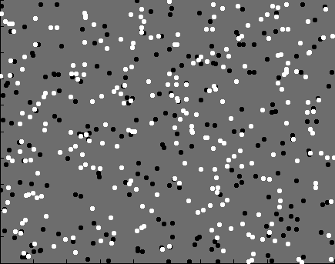

Slide 129
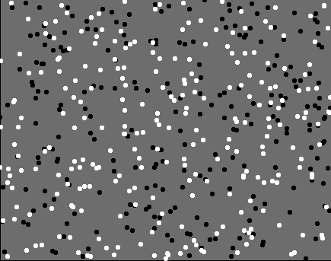

Slide 130
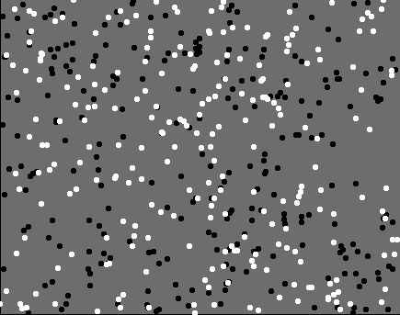

Slide 131
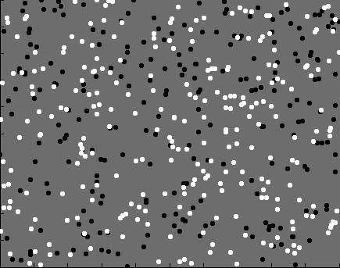

Slide 141
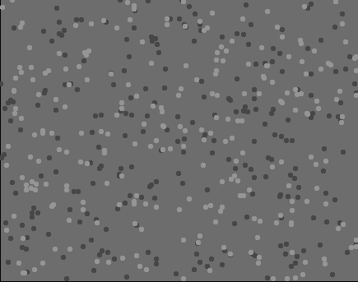

Slide 142
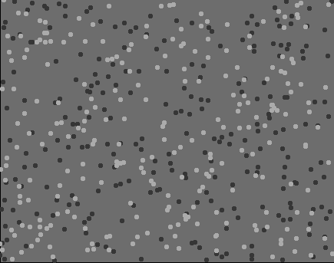

Slide 143
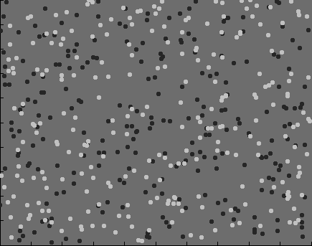

Slide 144
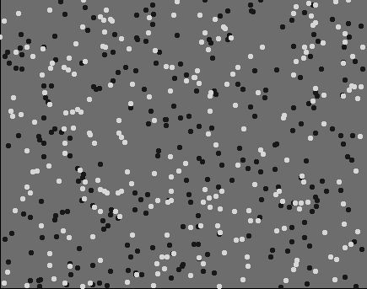

Slide 150
Model fits full dataset, not summary statistics

Slide 151
Model fits full dataset, not summary statistics
Details

Slide 160
Linking model: population representations to behavior

Slide 164
$$r_{trial}=β_{con}R\left(Δs_{con}\right)+β_{coh}R\left(Δs_{coh}\right)+β_{bias}$$

Slide 166
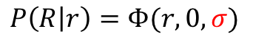
$$P\left(R | r\right)=Φ(r,0,σ)$$

Slide 167
Smaller sigma
(less noise)
$$P\left(R | r\right)=Φ(r,0,σ)$$

Slide 168
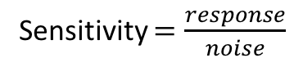
Sensitivity $=\frac{response}{noise}$
Smaller sigma
(less noise)
$$P\left(R | r\right)=Φ(r,0,σ)$$

Slide 169
Sensitivity $=\frac{response}{noise}$
Smaller sigma
(less noise)
How does noise scale with response magnitude?
$$P\left(R | r\right)=Φ(r,0,σ)$$

Slide 170
How does noise scale with response magnitude?

Slide 171
How does noise scale with response magnitude?

Slide 172
How does noise scale with response magnitude?
Feature strength

Slide 173
How does noise scale with response magnitude?
Feature strength

Slide 174
How does noise scale with response magnitude?
(in populations)
Feature strength

Slide 175
How does noise scale with response magnitude?
(in populations)
Feature strength

Slide 176
How does noise scale with response magnitude?
(in populations)
Feature strength

Slide 177
How does noise scale with response magnitude?
(in populations)
Feature strength
Feature strength

Slide 178
Response amplitude (s.d.)
Stimulus strength (%)

Slide 179
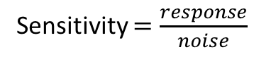
Response amplitude (s.d.)
Stimulus strength (%)
Stimulus strength (%)
Sensitivity $=\frac{response}{noise}$

Slide 180
Response amplitude (s.d.)
Stimulus strength (%)
Stimulus strength (%)
Sensitivity $=\frac{response}{noise}$

Slide 181
Response amplitude (s.d.)
Stimulus strength (%)
Sensitivity $=\frac{response}{noise}$

Slide 182
Response amplitude (s.d.)
Stimulus strength (%)
Sensitivity $=\frac{response}{noise}$

Slide 183
Response amplitude (s.d.)
Stimulus strength (%)
Stimulus strength (%)
Sensitivity $=\frac{response}{noise}$

Slide 184
Response amplitude (s.d.)
Stimulus strength (%)
Stimulus strength (%)

Slide 185
Response amplitude (s.d.)
Stimulus strength (%)
Stimulus strength (%)

Slide 186
Response amplitude (s.d.)
Stimulus strength (%)
Stimulus strength (%)

Slide 188
Additive noise

Slide 189
Additive noise

Slide 190

Additive noise
$$σ$$

Slide 191
Additive noise
$$σ$$
Units of % signal change!

Slide 192
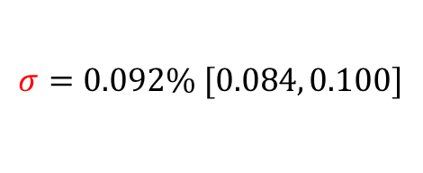
Additive noise
$$σ=0.092\% [0.084, 0.100]$$
Units of % signal change!

Slide 193
Additive noise
$$σ=0.092\% [0.084, 0.100]$$

Slide 194
Poisson noise

Slide 195
Poisson noise

Slide 196
Poisson noise

Slide 197
How does noise scale with response magnitude?
(in populations)

Slide 198
How does noise scale with response magnitude?
(in populations)

Slide 199
How does noise scale with response magnitude?
(in populations)

Slide 200
How does noise scale with response magnitude?
(in populations)

Slide 201
Goal: A model linking population representations of contrast and motion coherence to perception
Cortical measurements of BOLD fMRI
Evidence for similar nonlinear (Naka-Rushton) response functions to contrast and motion coherence
Behavioral measures of perception

Slide 202
Goal: A model linking population representations of contrast and motion coherence to perception
Cortical measurements of BOLD fMRI
Evidence for similar nonlinear (Naka-Rushton) response functions to contrast and motion coherence
Behavioral measures of perception

Slide 203
Goal: A model linking population representations of contrast and motion coherence to perception
Cortical measurements of BOLD fMRI
Evidence for similar nonlinear (Naka-Rushton) response functions to contrast and motion coherence
Behavioral measures of perception

Slide 204
Goal: A model linking population representations of contrast and motion coherence to perception
Cortical measurements of BOLD fMRI
Evidence for similar nonlinear (Naka-Rushton) response functions to contrast and motion coherence
Behavioral measures of perception
Judgments of contrast and motion coherence appear to be read out under additive noise

Slide 205
Goal: A joint model linking population representations of contrast and motion coherence to perception
Cortical measurements of BOLD fMRI
Evidence for similar nonlinear (Naka-Rushton) response functions to contrast and motion coherence
Behavioral measures of perception
Judgments of contrast and motion coherence appear to be read out under additive noise

Slide 206

Thanks!
Another person involved in this project
Justin Gardner

